Slide 1
Welcome to the Neighborhood meeting!

Slide 2
Marine Hills Neighborhood Meeting
Hosted via Zoom by the members of the Marine Hills Architectural Control Committee
Member & New Volunteer Introductions- 10 mins
Budget & Dues Update-Stephanie Pankuch-Saxton- 10 mins + 5 mins Q & A
Property Monitor Update- Jamrylyn Mallory- 10 mins + 5 mins Q & A
F-Dub Security Service Update= Josh Haglan- 10 mins + 10 min Q&A
Federal Way City Official Updates- 10 min each + 10 min Q&A
Lindsey Sperry FWPD Crime Analyst and Prevention Specialist
Desiree Winkler, the Deputy Public Works Director

Slide 3
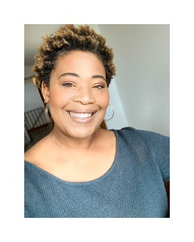
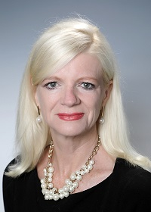
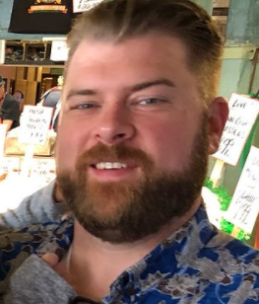
MEMBER INTRODUCTIONS
Jamyrlyn Mallory
MHACC Property Monitor Served as a volunteer on the MHACC board since 2019.
Penny Edlund
MHACC Member At Large Served as a volunteer on the MHACC board since fall 2018.
Stephanie Pankuch-Saxton
MHACC Treasurer Served as a volunteer on the MHACC board since 2019.
Levi Saxton
MHACC Webmaster
MHACC board since 2019.

Slide 4
NEW VOLUNTEERS!
Dee Lemus
Rick Battershell
John Meeker
Charmaine Rhea

Slide 5
MHACC BUDGET UPDATE

Slide 6
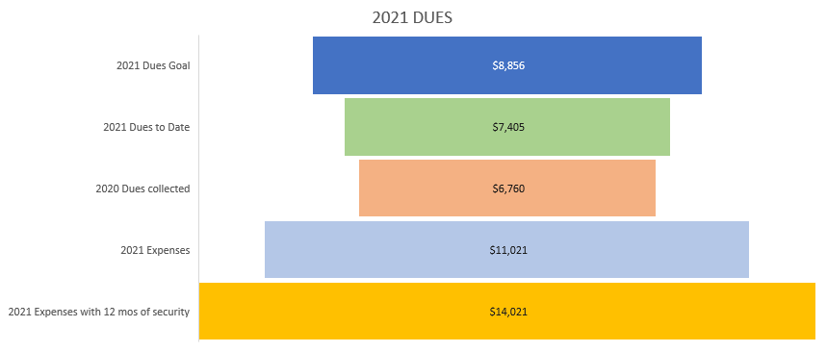
MHACC DUES UPDATE

Slide 7
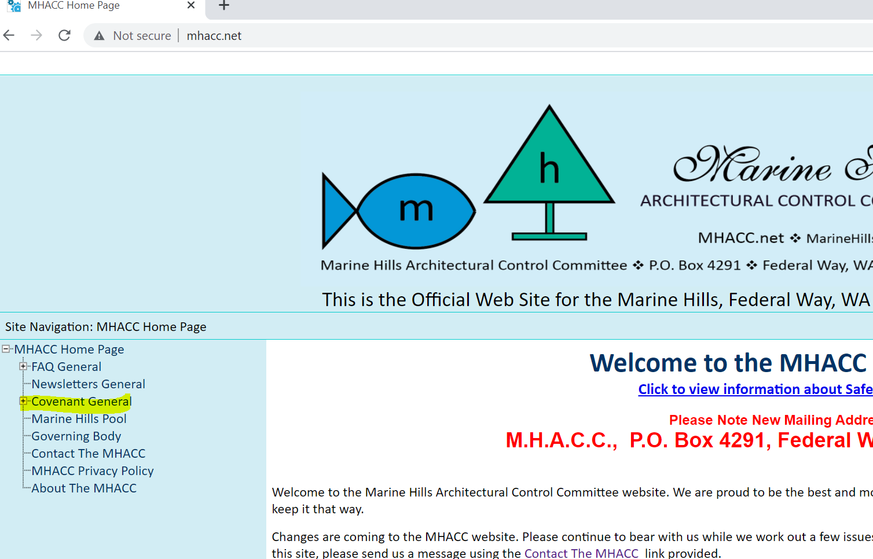
PROPERTY MONITOR UPDATE
FAQ’S 1. Tree Cutting /View Restriction 2. Marine Hills is overgrown 3. Parked Rv’s & Boats 4. Where do I find my plat? 5. Where do I find my Covenant Guidelines? 6. Are the Covenants legally binding? 7. How do I resolve a neighbor dispute?

Slide 8
VOLUNTEER REQUEST
We are still in need of Volunteers!
Secretary
Property Monitors
Welcome Committee
Safety Officer
Volunteer Commitment
Attend quarterly meetings
Contribute to bi-annual newsletters
1-2 hours per month in role specific duties
Communicate and engage with the neighborhood

Slide 9
GUEST SPEAKERS
Josh Haglan- Owner of F-Dub Security Services
Lindsey Sperry- FWPD Crime Analyst and Prevention Specialist
Desiree Winkler- Deputy Public Works Director

